Slide 1

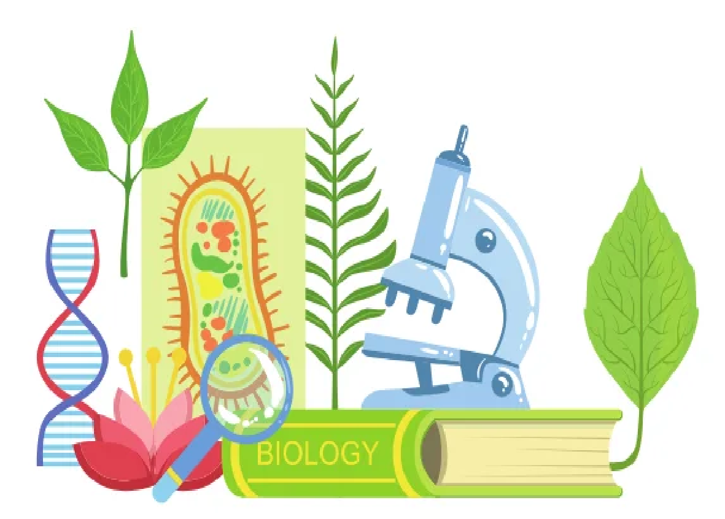
BIOLOGY FOR COMPUTER ENGINEERS- BBOC407
Module -4
NATURE-BIOINSPIRED MATERIALS AND MECHANISMS:
By
Dr. Srividya R
Associate Professor, Dept of ISE

Slide 2
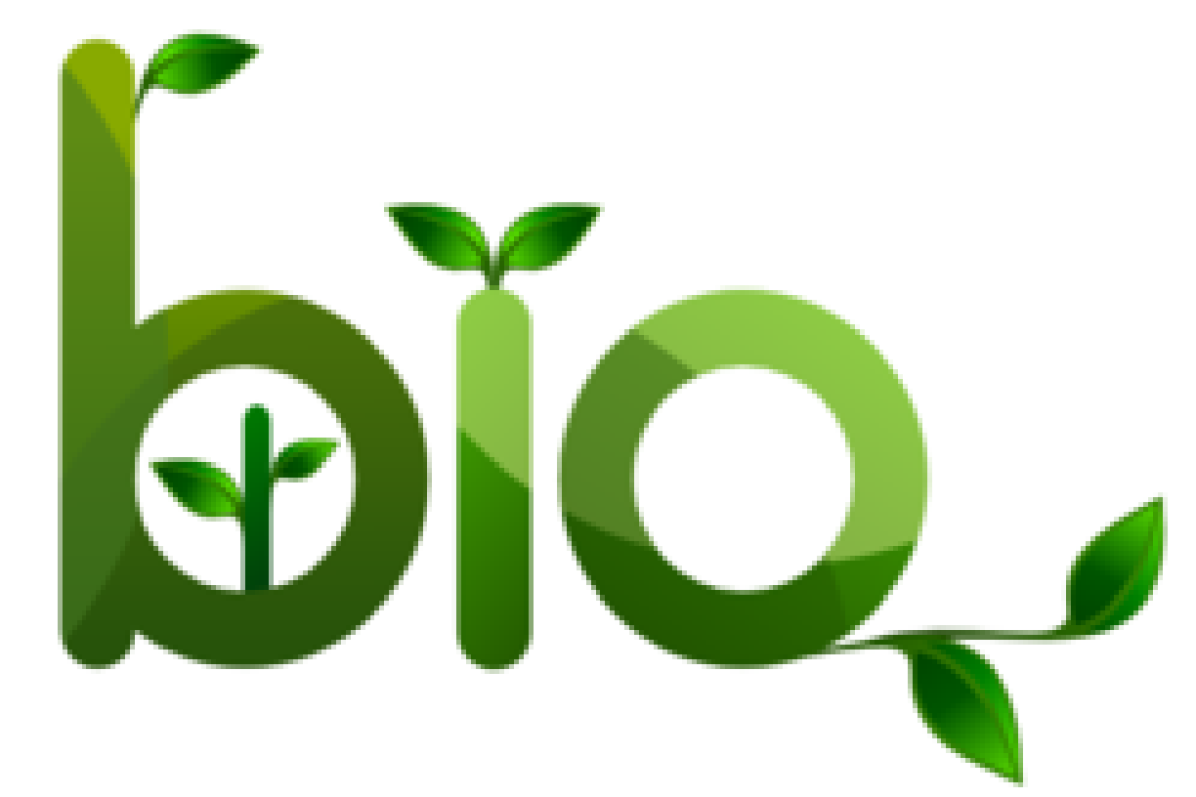
OVERVIEW
Echolocation
Photosynthesis
Bird flying, Lotus leaf effect,Plant burrs,Shark skin, Kingfisher beak.
Human Blood substitutes

Slide 3
Echolocation
In nature’s sonar system:
echolocation occurs when an animal emits a sound wave that bounces off an object, returning an echo
It provides information about the object’s distance and size.
Over a thousand species echolocate, including most bats, all-toothed whales, and small mammals.
Human echolocation is:
ability of humans to detect objects in their environment by sensing echoes and by creating sounds
Trained people can interpret the echoes accurately, identifying their location and size.

Slide 4
Mechanics Continued...
Vision and hearing are akin: each interprets reflected waves of energy.
Vision processes light waves:
light travel from their source, bounce off surfaces throughout the environment and enter the eyes.
Auditory system processes sound waves:
sound travel from their source, bounce off surfaces, and enter the ears.
In case of sound, these waves of reflected energy are referred to as echoes.

Slide 5
ULTRASONOGRAPHY (Ultrasound)
It refers to sound above human audible limit of 20 kHz.
Ultrasound of frequencies up to 10 MHz and beyond is used in medical diagnosis, therapy and surgery.
In investigative applications:
An ultrasound source (transmitter) directs pulses into the body.
When the pulse encounters a boundary between organs or between two tissue regions of different densities, reflections of sound occur.

Slide 6
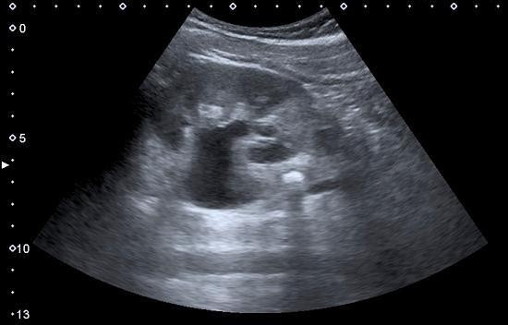

ULTRASONOGRAPHY (Ultrasound)
By scanning the body with Ultrasound and detecting echoes generated by various organs, a sonogram of the internal structure(s) can be generated.
The method is called diagnostic imaging by echolocation.
Diagnostic ultrasound(sonography or diagnostic medical sonography) :
it’s an imaging method that uses sound waves to produce images of structures within your body
Images provide valuable information for diagnosing and directing treatment for a variety of diseases.
SONOGRAPHY OF KIDNEY

Slide 7
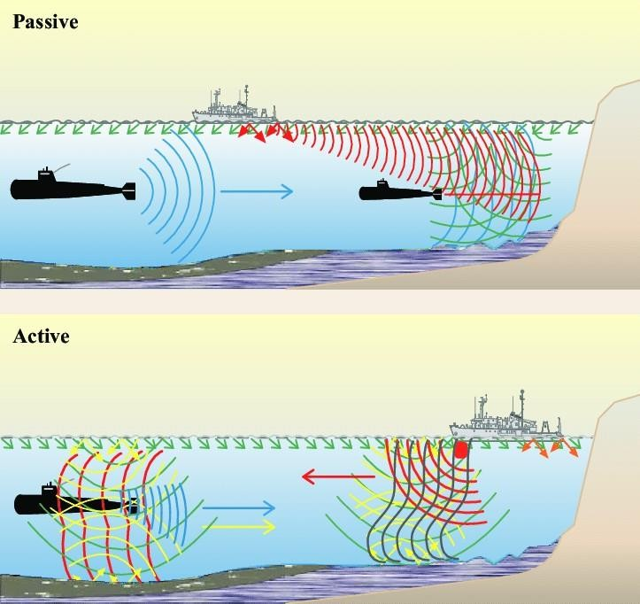
SONARS- Sound/Sonic Navigation & Ranging
It is a technique that uses sound propagation to navigate, measure distances (ranging), or detect objects on or under the surface of water.
"Sonar" can refer to one of two types of technology:
Passive sonar: listening the sound made by vessels.
Active sonar: emitting pulses of sounds and listening for echoes

Slide 8
SONARS- Sound/Sonic Navigation & Ranging
The term sonar is also used for the equipment used to generate and receive the sound.
Sonar may be used:
As a means of: acoustic location and measurement of the "targets"echo characteristics.
For robot navigation, and SODAR
SODAR (an upward-looking,in-air, sonar) is used for atmospheric investigations.
The acoustic frequencies used in sonar systems vary from very low (infrasonic) to extremely high (ultrasonic).
The study of underwater sound is known as underwater acoustics or hydroacoustics.

Slide 9
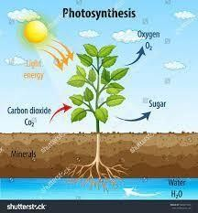
Photosynthesis
Photosynthesis process is carried out by plants, algae, and some types of bacteria.
They capture energy, from sunlight, to produce:
oxygen (O2) and
chemical energy stored in glucose (a sugar).
Herbivores then obtain this energy by eating plants, and carnivores obtain it by eating herbivores.
During photosynthesis: plants take in CO2 and water H2O from the air and soil.

Slide 10
Continued...
The Process:
Within plant cell, water is oxidized (loses electrons), while carbon dioxide is reduced(gains electrons).
This transforms water into oxygen and carbon dioxide into glucose.
The plant then releases oxygen back into air and stores energy within the glucose molecules.
Chlorophyll:
Chloroplasts in plant cell, store energy of sunlight.
Chloroplasts have thylakoid membranes with light-absorbing pigment called chlorophyll.
During photosynthesis, chlorophyll absorbs energy from blue- and red-light waves and reflects green-light waves, making the plant appear green.

Slide 11
PHOTOVOLTAIC CELLS
Sun’s energy is captured by 2 engineering systems: photosynthetic plant cells and photovoltaic cells (PV).
Photosynthesis converts solar energy into chemical energy.
Photovoltaics turn solar energy into electricity which can be stored and used.
One of the applications that contribute to bringing together photosynthesis and photovoltaics is the Photovoltaic cell.

Slide 12
PHOTOVOLTAIC CELLS
Solar cell:
It’s an electronic device that converts the energy of light directly into electricity by the photovoltaic effect
It is defined as:
The Device whose electrical characteristics, such as current, voltage, or resistance, vary
when exposed to light.
Solar cells are electrical building blocks of photovoltaic modules, known as solar panels.
The common single-junction, silicon solar cell, can produce, a maximum open-circuit voltage of approximately 0.5 volts to 0.6 volts.

Slide 13
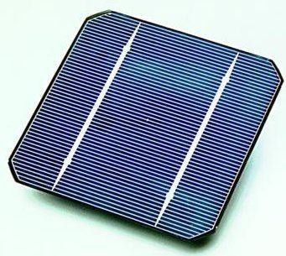
PHOTOVOLTAIC CELLS
Application:
•Remote Locations
•Stand-Alone Power.
•Power in Space.
•Building-Related Needs.
•Military Uses.
•Transportation.

Slide 14
BIONIC LEAF
It is a biomimetic system that gathers solar energy via photovoltaic cells.
This energy can be stored or used in several different functions.
They can be composed of:
Both synthetic (metals, ceramics, polymers, etc.) and organic materials (bacteria), or
Solely made of synthetic materials.
It has the potential to be implemented in urbanized areas to provide:
clean air
clean energy.

Slide 15
BIONIC LEAF- Mechanics
Natural Photosynthesis vs The Bionic Leaf at its simplest form.
In natural photosynthesis, photosynthetic organisms produce energy-rich organic molecules from water and carbon dioxide by using solar radiation.
Therefore, the process of photosynthesis removes carbon dioxide, from the air.
Artificial photosynthesis, as performed by the Bionic Leaf, is approximately 10 times more efficient than natural photosynthesis.
Using a catalyst, the Bionic Leaf can remove excess carbon dioxide in the air and convert that to use alcohol fuels, like isopropanol and isobutanol.
The efficiency of the Bionic Leaf's artificial photosynthesis is due to bypassing obstacles in natural photosynthesis through its artificiality.

Slide 16
BIONIC LEAF- Mechanics
Natural Photosynthesis
Bionic Leaf
Photosynthetic organisms produce energy-rich organic molecules from H2O and CO2 by using solar radiation.
Most plants do not exceed 1% efficiency and even microalgae grown in bioreactors do not exceed 3%.
In natural systems, numerous energy conversion bottlenecks limit the overall efficiency of photosynthesis
This process removes CO2, from the air.
Using a catalyst, it can remove excess CO2 in the air and convert that to use, alcohol fuels, like isopropanol and isobutanol.
Its approximately 10 times more efficient than natural photosynthesis.
Effeciency is due to bypassing obstacles in natural photosynthesis through its artificiality.
Existing artificial photosynthetic solar-to-fuels cycles may exceed natural efficiencies but cannot complete the cycle via carbon fixation.

Slide 17
BIONIC LEAF- Mechanics
When the catalysts of the Bionic Leaf are coupled with the bacterium Ralstonia eutropha, this results in a hybrid system capable of CO2 fixation.
This system can store more than half of its input energy as products of CO2 fixation.
Overall, the hybrid design allows for artificial photosynthesis with efficiencies rivaling that of natural photosynthesis.

Slide 18
BIONIC LEAF
Application
•Agriculture
•Atmosphere
•Bionic Facades

Slide 19
Bird flying
Bird flight is the primary mode of locomotion used by birds in which birds take off and fly.
Flight assists birds with feeding, breeding, avoiding predators, and migrating.
Bird flight is one of the most complex forms of locomotion in the animal kingdom.
Each facet of this type of motion, including hovering, taking off, and landing, involves many complex movements.
As they adapted and evolved they developed:
specializations in their wings and
acquired different forms of flight

Slide 20

Global Positioning System
GPS is a system. It’s made up of 3 parts: satellites, ground stations, and receivers.
Satellites act like stars in constellations—we know where they are supposed to be at any given time.
The Ground stations use radar to make sure they are actually where we think they are.
A Receiver is constantly listening, for signals, from these satellites.
The receiver figures out how far they are from some of them.
Once the receiver calculates its distance from 4 or more satellites, it knows exactly where you are.
From miles up in space location on the ground can be determined with incredible precision!

Slide 21
GPS AND BIRD FLIGHT
Scientists have long known that birds navigate using the earth’s magnetic field.
A new study has found mechanics in brain of pigeons that allow them to find their way.
A team at Baylor College of Medicine in the U.S. identified a group of 53 cells in a pigeon’s brain.
These cells record detailed information on Earth’s magnetic field.
It is a kind of internal global positioning system (GPS).

Slide 22
GPS AND BIRD FLIGHT- Experiment
Prof. Dickman and his colleague Le-Qing Wu set up an experiment:
Pigeons were held in a dark room.
3D coil system was used to cancel out natural geomagnetic field and
They generated a tunable, artificial magnetic field inside the room.
They adjusted the elevation angles and magnitude of the artificial magnetic field.
They simultaneously recorded the activity of the 53 neurons in the pigeons’ brain.
The neurons were identified as candidates for such sensors.

Slide 23
GPS AND BIRD FLIGHT- Experiment
They measured the electrical signals from each neuron as the field was changed.
They found that every neuron had its characteristic response to the magnetic field.
Also researchers found that purported compass cells in pigeon beaks were a type of white blood cell.
Neurons gave a sort of 3-D compass reading along
the north-south directions.
as well as pointing directly upward or downward.
Finally the researchers said this could help the bird determine:
it's heading just as a compass does
also reveal its approximate position

Slide 24
Aircraft-Mechanism...
Lift, Drag, and Thrust:
The fundamentals of bird flight are similar to those of aircraft.
In Aircrafts the aerodynamic forces sustain flight lift, drag, and thrust.
Lift force is produced by the action of airflow on the wing, which is an airfoil.
The airfoil is shaped such that:
air provides an upward force on the wing,
but the movement of air is directed downward.
The additional net lift may come from airflow around the bird's body, especially while the wings are folded or semi-folded.

Slide 25
Aircraft-Mechanism...
Aerodynamic drag is the force opposite to direction of motion, and this causes energy loss in flight.
The drag force can be separated into 2 portions:
Lift-induced drag: It is the inherent cost of the wing producing lift and
Parasitic drag: Including skin friction drag from the friction of air and body surfaces and form drag from the bird's frontal area.
The streamlining of the bird's body and wings reduces these forces.
Thrust: birds flap their wings with a given flapping amplitude and frequency to generate thrust.

Slide 26
Lotus leaf effect
The lotus leaf is well-known for having a highly water-repellent or superhydrophobic surface.
Thus the name lotus effect.
Water repellency mechanism is used in the development of self-cleaning materials.
It has been studied in both natural and artificial systems.

Slide 27

SUPERHYDROPHOBIC AND SELF-CLEANING SURFACES
The self-cleaning function of superhydrophobic surfaces means removal of contaminating particles.
It can be done by impacting or rolling water droplets.
A unique self-cleaning mechanism:
Here, the contaminated superhydrophobic surface is exposed to condensing water vapor
The contaminants are removed by self-propelled jumping motion of the resulting liquid condensate
The liquid condensate partially or fully covers the contaminating particles.
The jumping motion of the surface is due to energy released by coalescence of condensed water around contaminants.

Slide 28
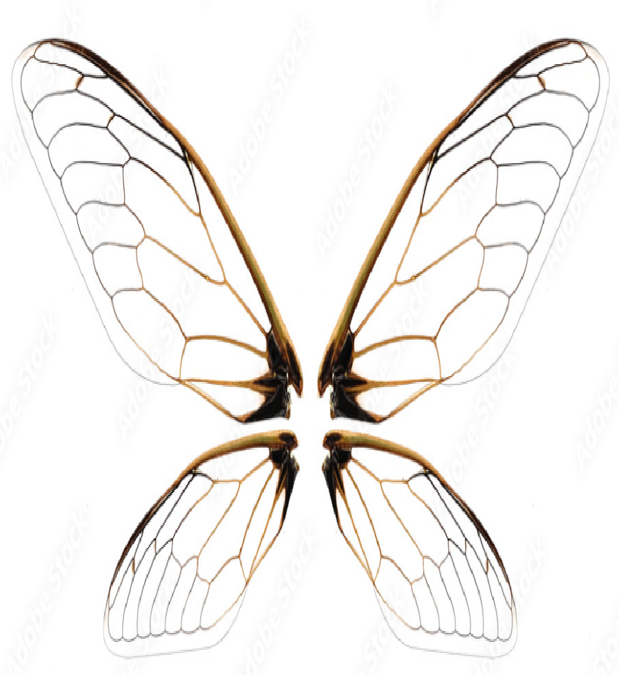
SUPERHYDROPHOBIC AND SELF-CLEANING SURFACES
The jumping-condensate mechanism spontaneously clean superhydrophobic cicada wings.
Here the contaminating particles cannot be removed by gravity, wing vibration, or wind flow.
These findings offer insights into the development of self-cleaning materials.

Slide 29
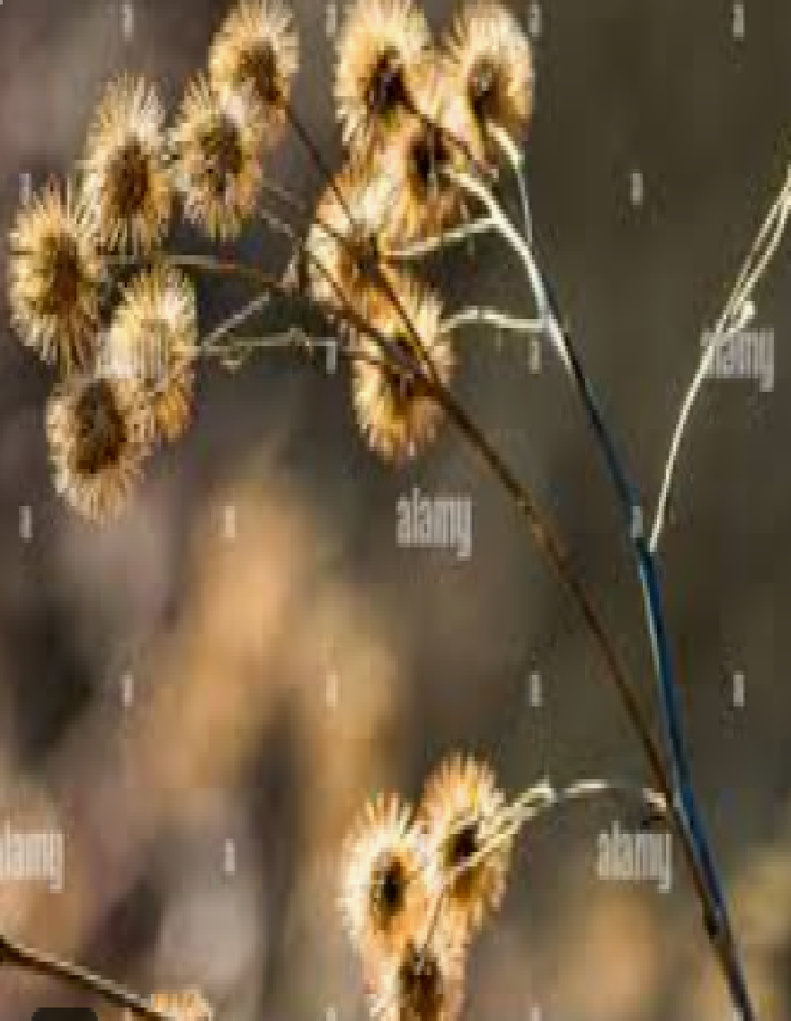
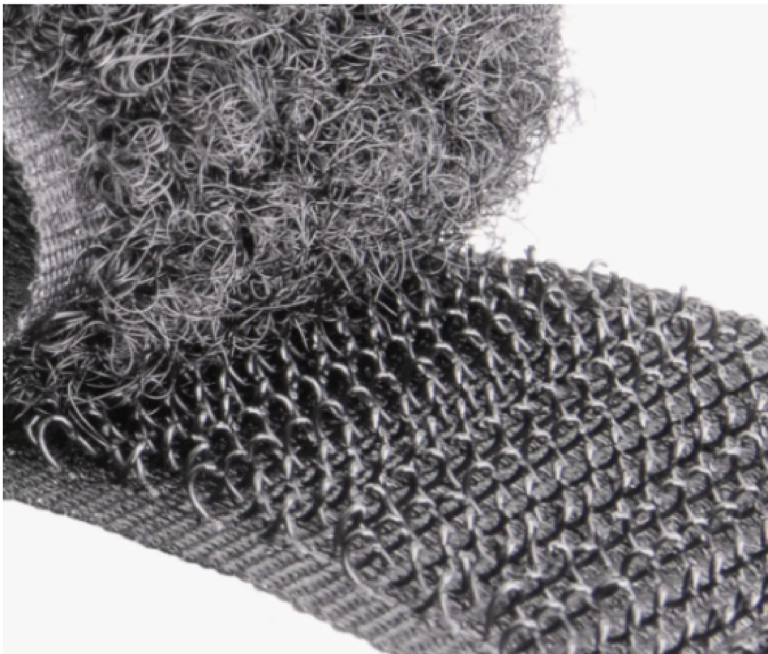

Plant Burrs
A bur is a seed or dry fruit that has hooks or teeth.
The main function of the bur is to spread the seeds of the bur plant.
Hooks of the bur are used to catch on to fur or fabric, so that seeds can be transported along with the fabric it gets attached.
Another use is physical protection against herbivores.
Their ability to stick to animals and fabrics has shaped their reputation as bothersome.
The number of burs per fruit, their size and shape can vary largely between different bur plants.

Slide 30
Relevance to humans...
Burs are sources of irritation, injury, damage to clothing, punctures to tires, and clogging agricultural equipment.
Bur plants can be labeled as weeds.
Methods of controlling the spread of bur plants include:
use of herbicides
slashing and
cultivation among others.
Some are used for fabric fulling (cleansing of woven cloth ).
The bur was the inspiration for the hook and loop fastener, also known as Velcro.

Slide 31
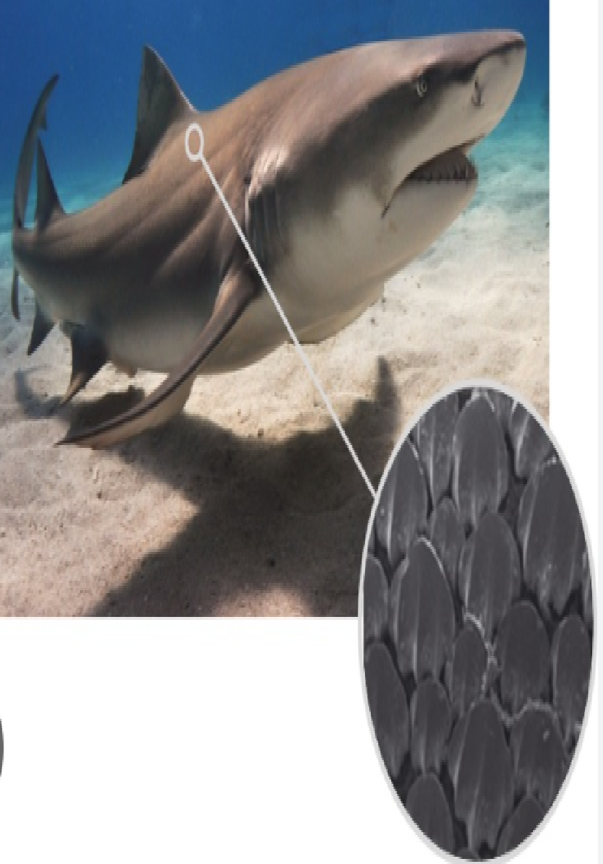
Shark skin
The texture is rough since it has small scales similar to teeth, called Dermal Denticles.
They have a covering of:
Dentine
Central pulp canal containing blood vessels and
Single nerve.
The denticles play an important part in swimming.
Water is channeled by ‘skin teeth' and flows across fins and around the body.
Teeth and skin help protect shark from injuries.
It's like a suit of armor for sharks

Slide 32
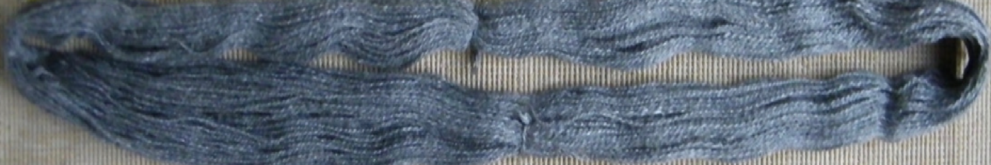
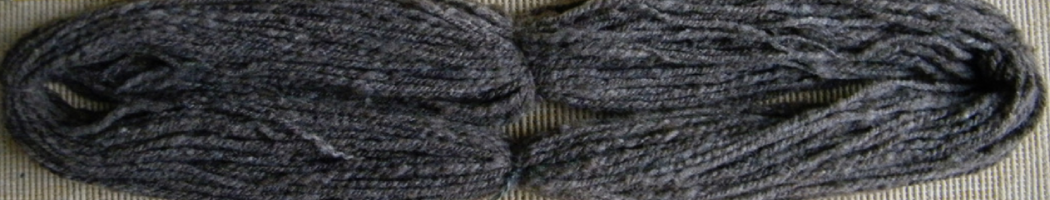
Relevance to humans...
Sharkskin fabric is typically made with:
acetate and rayon yarns, and
worsted (name of place) wool and
various synthetic blends.
The combination of the color of the yarns and the twill weaving pattern results in an excellent finish.
It has a smooth but crisp texture and a 2-tone lustrous appearance.
Lightweight and wrinkle-free, sharkskin is ideal for curtains, tablecloths, and napkins.
It is popular for suits, light winter jackets, and coats.
It is commonly used as a liner in diving suits and wetsuits.

Slide 33
SHARK SKIN AND SWIMSUITS...
Scientists have been able to replicate the dermal denticles in:
Swimsuits and
Bottom of ships or boats.
Sharkskin mechanism is used to create surfaces in hospitals that resist bacteria.
Sharkskin-inspired swimsuits received a lot of media attention during the 2008 Summer Olympics.
However, they are now banned in most of major competitions.

Slide 34
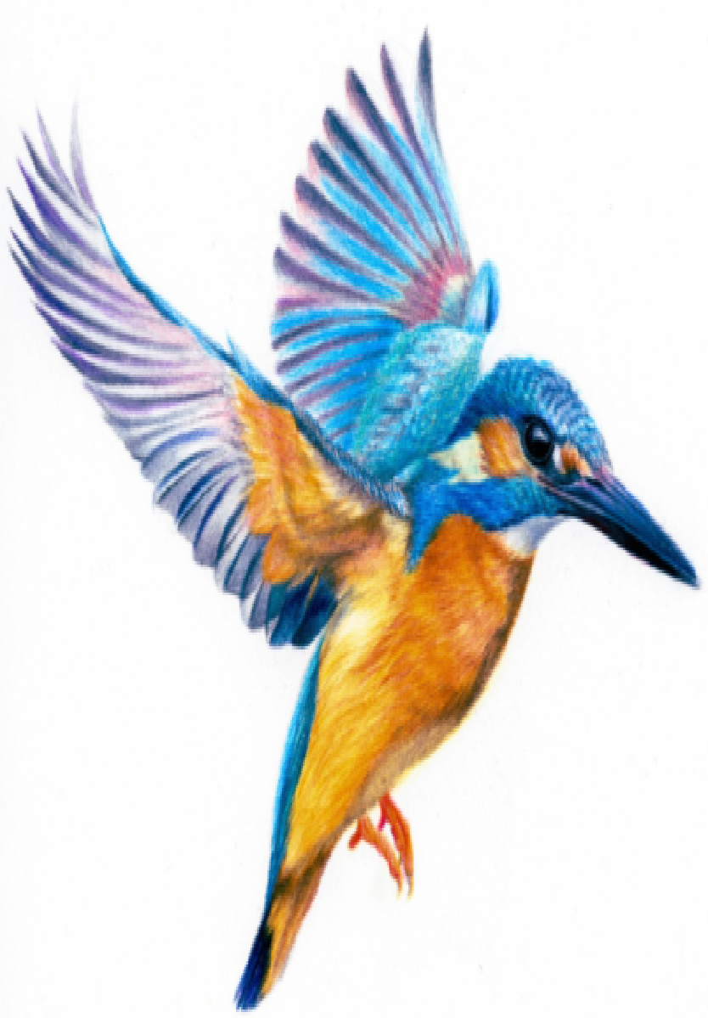
Kingfisher beak
The kingfishers have long, dagger-like bills.
The bill is usually:
longer and more compressed in species that hunt fish, and
shorter and broader in species that hunt prey off the ground.
Relationship with humans:
Kingfishers are generally shy birds,with following features:
large head supporting its powerful mouth,
bright plumage (Feathers) &
interesting behavior.

Slide 35
Kingfisher beak THAT INSPIRED A BULLET TRAIN
STRATEGY:
The secret is in the shape of the kingfisher’s beak.
It has a long and narrow cone beak, that enters the water without creating a compression wave below the surface or a noisy splash above.
This helps bird to reach the fish in milliseconds, before the fish knows to flee.
Length of the beak is critical here: the longer it is, the more gradually the angle of wedge expands.

Slide 36
Kingfisher beak THAT INSPIRED A BULLET TRAIN
Potential:
Eiji Nakatsu, is the chief engineer of the company operating Japan’s fastest trains.
He wondered if the kingfisher’s beak might serve as a model to redesign trains.
So that they dont create thunderous noise when leaving tunnels.
As they tested different shapes for front of the new train, the train became quieter and more efficient as the geometry became more like the shape of a kingfisher’s beak.
It required 15% less energy while traveling even faster than before.

Slide 37
Human Blood Substitutes
Concerns that fueled development of blood substitutes are :
Shortages in blood supplies and
Safety of donated blood
The 2 major types of blood substitutes are:
Volume expanders: Include solutions (saline) that are used to replace lost plasma volume, and
Oxygen therapeutics: These are agents that replace oxygen normally carried by hemoglobin in RBC
Of these 2 types development of oxygen therapeutics has been the most challenging.

Slide 38
Human Blood Substitutes
One of the first groups of agents developed and tested were Per flu oro carbons.
They effectively transport and deliver oxygen to tissues but cause complex side effects and are not metabolized by the body.
Other oxygen therapeutics include agents called Hemoglobin-Based Oxygen Carriers (HBOCs).
These are made by genetically or chemically engineering hemoglobin.
HBOC’s Benefits:
HBOC’s do not require refrigeration.
They are compatible with all blood types and
They efficiently distribute oxygen to tissues.

Slide 39
Human Blood Substitutes
A primary concern associated with HBOCs is their potential to cause severe immune reactions.
Blood from human umbilical cord has been studied so as to substitute RBC’s for transfusion.
RBC’s can be extracted from cord blood via sedimentation as the blood is cooled.
Research about the transfusion is ongoing.
Concern for their implementation are:
Establishment of safe, effective and ethical procedures for cord blood collection.
Development of criteria that help to ensure safe transfusion and
Preservation of cord blood quality.

Slide 40
Hemoglobin-Based Oxygen Carriers (HBOCs)
Pharmaceutical companies attempted to develop HBOCs and PFCs starting in the 1980s.
At first, seemed to have some success but human clinical trials were disappointing.
A study published in 2008 in Journal of the American Medical Association summarized the results of:
16 clinical trials
On 5 different blood substitutes
Administered to 3,500 patients.
Those receiving blood substitutes had a 3-fold increase in risk of heart attacks compared with the group given human donor blood.

Slide 41
Hemoglobin-based oxygen carriers (HBOCs)
However, some of the negative statistics were misleading.
The artificial blood products varied in their benefits and risks, and
Some blood substitutes had very few serious side effects.
Some blood substitutes are safer and more beneficial than scientists thought.

Slide 42
Hemoglobin-Based Oxygen Carriers (HBOCs)
HBOCs are “made of” natural hemoglobins that were originally developed as blood substitutes.
Addition of HBOCs to traditional preservation protocols provides:
more oxygen to organs, to meet their energy metabolic needs,
prolongs preservation time,
reduces ischemia-reperfusion injury to grafts,
improves graft quality, and
even increases the number of transplantable donors.

Slide 43
Hemoglobin-based oxygen carriers (HBOCs)
Focus of the present study was:
To review the potential applications of HBOCs in solid organ preservation and
Provide new approaches to understand the strategies for organ preservation.

Slide 44

Perflourocarbons (PFCs)
PFCs remain in bloodstream for about 48 hours.
PFCs were the first group of artificial blood products studied by scientists, because of their oxygen-dissolving ability.
PFCs are usually white and are a good oxygen carriers.
PFCs must be emulsified before they can be given to patients, since they do not mix with blood.
Researchers are now trying to find out if they can reduce swollen brain tissue in traumatic brain injury using PFCs.
PFC particles may cause flu-like symptoms in some patients when they exhale these compounds.

Slide 45
THANK YOU

